Slide 1
Machine Learning An Alogrithm Persepective
Second Edition
by Stephen Marsland

Slide 2
CHAPTER 3 Neurons, Neural Networks, and Linear Discriminants
3.1 THE BRAIN AND THE NEURON
transmitter chemicals within the fluid of the brain raise or lower the electrical potential inside the body of the neuron.
If this membrane potential reaches some threshold, the neuron spikes or fires, and a pulse of fixed strength and duration is sent down the axon.
The axons divide (arborise) into connections to many other neurons, connecting to each of these neurons in a synapse.
After firing, the neuron must wait for some time to recover its energy (the refractory period) before it can fire again.

Slide 3
So how does learning occur in the brain?
The principal concept is plasticity: modifying the strength of synaptic connections between neurons, and creating new connections.

Slide 4
3.1.1 Hebb's Rule
Hebb's rule says that:
the changes in the strength of synaptic connections are proportional to the correlation in the firing of the two connecting neurons.
So if two neurons consistently fire simultaneously, then any connection between them will change in strength, becoming stronger.
However, if the two neurons never fire simultaneously, the connection between them will die away.
The idea is:
that if two neurons both respond to something, then they should be connected.
Pavlov used this idea, called classical conditioning
other names for this idea is also known as long-term potentiation and neural plasticity

Slide 5
3.1.2 McCulloch and Pitts Neurons
McCulloch and Pitts modelled a neuron as:

Slide 6
(1) a set of weighted inputs w_{i} that correspond to the synapses
(2) an adder that sums the input signals (equivalent to the membrane of the cell that collects electrical charge)
(3) an activation function (initially a threshold function) that decides whether the neuron fires (‘spikes’) for the current inputs
the weights w_{i} can be positive or negative.
This corresponds to excitatory and inhibitory connections that make neurons more likely to fire and less likely to fire, respectively.

Slide 7
The McCulloch and Pitts neuron is a binary threshold device.
It sums up the inputs (multiplied by the synaptic strengths or weights)
and either fires (produces output 1) or does not fire (produces output 0) depending on whether the input is above some threshold.
activation function

Slide 8
3.2 NEURAL NETWORKS
we need to put sets of neurons together into neural networks so that they can do something useful.
supervised learning
generalisation
pattern recognition
Have a look at the McCulloch and Pitts neuron and try to work out what can change in that model.
The only things that make up the neuron are
the inputs, the weights, and the threshold (and there is only one threshold for each neuron, but lots of inputs).
most of the learning is in the weights

Slide 9
How should we change the weights and thresholds of the neurons so that the network gets the right answer more often?
Perceptron

Slide 10
3.3 THE PERCEPTRON
The Perceptron is nothing more than a collection of McCulloch and Pitts neurons together with a set of inputs and some weights to fasten the inputs to the neurons.
the neurons in the Perceptron are completely independent of each other

Slide 11
The neuron works out whether or not to fire by
multiplying together its own weights and the input,
adding them together,
and comparing the result to its own threshold, regardless of what the other neurons are doing.
in general, there will be m inputs and n neurons.
the weight , we label them as w_{ij} , where the j index runs over the number of neurons. i.e. it's from input i to neuron j.
whether or not a neuron should fire:
activation function provide a vector of 0s and 1s.

Slide 12
If it failed to fire when it should, it needs to have its weights changed.
how to change the values of those weights.
The first thing we need to know is whether each weight is too big or too small.
some of the weights will be too big if the neuron fired when it shouldn't have, and too small if it didn't fire when it should.
So we compute y_{k} −t_{k} (the difference between the output y_{k}, which is what the neuron did, and the target for that neuron, t_{k}, which is what the neuron should have done. This is a possible error function).
If it is negative then the neuron should have fired and didn't, so we make the weights bigger,
and vice versa if it is positive, which we can do by subtracting the error value.

Slide 13
That element of the input could be negative, which would switch the values over; so
Δw_{ik} = −(y_{k} − t_{k}) × x_{i}
w_{ij}←w_{ij} − η(y_{j} − t_{j}) · x_{i}
η--learning rate, The value of the learning rate decides how fast the network learns.

Slide 14
3.3.1 The Learning Rate η
The cost of having a small learning rate is that the weights need to see the inputs more often before they change significantly, so that the network takes longer to learn.
However, it will be more stable and resistant to noise (errors) and inaccuracies in the data.
We therefore use a moderate learning rate, typically 0.1 < η < 0.4, depending upon how much error we expect in the inputs.

Slide 15
3.3.2 The Bias Input
the McCulloch and Pitts neuron, we gave each neuron a firing threshold θ that determined what value it needed before it should fire.
This threshold should be adjustable, so that we can change the value that the neuron fires at.

Slide 16
an extra input weight to the neuron, with the value of the input to that weight always being fixed (usually the value of -± is chosen; we use -1 to make it stand out, but any non-zero value will do)
the value of the weight will change to make the neuron fire
This input is called a bias node, and its weights are usually given a 0 subscript, so that the weight connecting it to the jth neuron is w_{0j} .

Slide 17
3.3.3 The Perceptron Learning Algorithm
The algorithm is separated into two parts:
a training phase, and a recall phase.
The recall phase is used after training, and it is the one that should be fast to use, since it will be used far more often than the training phase.
the training phase uses the recall equation, since it has to work out the activations of the neurons before the error can be calculated and the weights trained.

Slide 18
The Perceptron Algorithm
Initialisation
– set all of the weights w_{ij} to small (positive and negative) random numbers
Training
– for T iterations or until all the outputs are correct:
* for each input vector:
compute the activation of each neuron j using activation function g:
update each of the weights individually using:

Slide 19
Recall
– compute the activation of each neuron j using:

Slide 20
the computational complexity of this algorithm
The recall phase loops over the neurons, and within that loops over the inputs, so its complexity is O(mn).
The training part does this same thing, but does it for T iterations, so costs O(Tmn).

Slide 21
3.3.4 An Example of Perceptron Learning: Logic Functions

Slide 22
initialise the weights to small random numbers, so w0 = −0.05,w1 = −0.02,w2 = 0.02.
first input: (0, 0). bias input is always −1.
activiation: −0.05 × −1 +−0.02 × 0 + 0.02 × 0 = 0.05.
This value is above 0, so the neuron fires and the output is 1, which is incorrect according to the target.
to update each of the weights separately

Slide 23
the next input (0, 1) and compute the output, then apply the learning rule again:
For the (1, 0) input, the answer is already correct (you should check that you agree with this), so we don’t have to update the weights at all,
and the same is true for the (1, 1) input.

Slide 24
We now need to start going through the inputs again, until the weights settle down and stop changing,
which is what tells us that the algorithm has finished.
For real-world applications the weights may never stop changing,
which is why you run the algorithm for some pre-set number of iterations, T.

Slide 25
there are lots of different values that we can assign to the weights that will give the correct outputs;
the weights that the algorithm finds depend on
the learning rate, the inputs, and the initial starting values.
We are interested in finding a set that works;
we don't necessarily care what the actual values are, providing that the network generalises to other inputs.

Slide 26
3.3.5 Implementation
it is normal to arrange the training data into a two-dimensional array, with each row of the array being a datapoint.
Python: training

Slide 27
Python's numerical library NumPy provides an alternative method
We can write the set of weights for the network in a matrix by making an np.array that has m + 1 rows (the number of input nodes + 1 for the bias) and n columns (the number of neurons).
the element of the matrix at location (i, j) contains the weight connecting input i to neuron j,
NumPy: Matrix multiplication--- np.dot() function
For example:
>>> import numpy as np
>>> a = np.array([[3,4,5],[2,3,4]])
>>> b = np.array([[1,3],[2,4],[3,5]])
>>> np.dot(a,b)
array([[26, 50],
[20, 38]])

Slide 28
We can put the input vectors into a two-dimensional array of size N ×m,
where N is the number of input vectors we have and m is the number of inputs.
The weights array is of size m×n,
multiply them, then the output will be an N ×n matrix
that holds the values of the sum that each neuron computes for each of the N input vectors.
we just need to compute the activations based on these sums.

Slide 29
NumPy: function np.where(condition,x,y),
condition is a logical condition and x and y are values
that returns a matrix that has value x where condition is true and value y verywhere else.
For example:
>>> a = np.array([[3,4,5],[2,3,4]])
>>> np.where(a>3,1,0)
array([[0, 1, 1],
[0, 0, 1]])

Slide 30
recall function of the Perceptron
# Compute activations
activations = np.dot(inputs,self.weights)
# Threshold the activations
return np.where(activations>0,1,0)

Slide 31
to compute the weight updates.
The weights are in an m×n matrix, the activations are in an N ×n matrix (as are the targets)
and the inputs are in an N×m matrix.
So to do the multiplication np.dot(inputs,targets-activations)
we need to turn the inputs matrix around so that it is m × N.
This is done using the np.transpose() function, which swaps the rows and columns over.
self.weights -= eta*np.dot(np.transpose(inputs),self.activations-targets)

Slide 32
input matrices are needed to add those extra −1's onto the input vectors for the bias node.
using the np.concatenate() function
inputs = np.concatenate((inputs,-np.ones((self.nData,1))),axis=1)
axis, The axis along which the arrays will be jointed. default is 0.

Slide 33
to give initial values to the weights, assign small random numbers to the weights
weights = np.random.rand(nIn+1,nOut)*0.1-0.05
nin corresponding to m and nout to n

Slide 34
3.4 LINEAR SEPARABILITY
What does the Perceptron actually compute?
it tries to find a straight line (in 2D, a plane in 3D, and a hyperplane in higher dimensions)
where the neuron fires on one side of the line, and doesn't on the other.
This line is called the decision boundary or discriminant function
The neuron fires if x·w^{T} > 0 (where w is the row of W that connects the inputs to one particular neuron
inner or scalar product

Slide 35
to the Perceptron, the boundary case is
where we find an input vector x1 that has x1 · w^{T} = 0.
find another input vector x2 that satisfies x2 · w^{T} = 0.
Putting these two equations together we get:

Slide 36
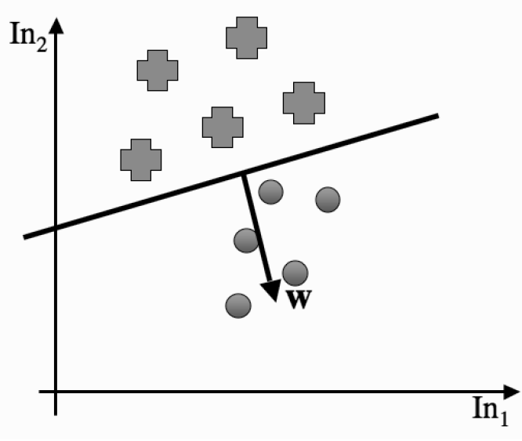
Now x1 − x2 is a straight line between two points that lie on the decision boundary,
and the weight vector w^{T} must be perpendicular to that

Slide 37
So given some data, and the associated target outputs, the Perceptron simply tries to find a straight line (hyperplane) that divides the examples where each neuron fires from those where it does not.
The cases where there is a straight line are called linearly separable cases.

Slide 38
3.4.1 The Perceptron Convergence Theorem
Rosenblatt's 1962 proof that,
given a linearly separable dataset, the Perceptron will converge to a solution that separates the classes,
and that it will do it after a finite number of iterations.
the number of iterations is bounded by 1/γ²,
where γ is the distance between the separating hyperplane and the closest datapoint to it.

Slide 39
The proof of this theorem
assume that the length of every input vector ||x||< 1, although it isn't strictly necessary provided that they are bounded by some constant R.
First, there is some weight vector w* that separates the data, since we have assumed that it is linearly separable.
The Perceptron learning algorithm aims to find some vector w that is parallel to w*, or as close as possible.
we use the inner product w* · w.
When the two vectors are parallel, the angle between them is θ = 0 and so cosθ = 1, and so the size of the inner product is a maximum.

Slide 40
therefore, If we show that at each weight update w* · w increases, then we have nearly shown that the algorithm will converge.
However, because w* · w = ||w*|| ·||w|| cosθ, and so we also need to check that the length of w does not increase too much as well.
Hence, there are two checks that we need to make:
the value of w* · w
and the length of w.

Slide 41
Suppose that at the tth iteration of the algorithm, the network sees a particular input x that should have output y, and that it gets this input wrong, so yw^{(t−1)} · x < 0,
where the (t−1) index means the weights at the (t−1)st step.
This means that the weights need to be updated.
This weight update will be w^{(t)} = w^{(t−1)} +yx (where we have set η = 1 for simplicity, and because it is fine for the Perceptron.

Slide 42
This means that at each update of the weights, this inner product increases by at least γ, and so after t updates of the weights, w* · w^{(t)}>= tγ.
put a lower bound on the length of ||w^{(t)}|| by using the Cauchy–Schwartz inequality, which tells us that w*· w^{(t)}<=||w*|| ·||w^{(t)}|| , so
tγ<=w*· w^{(t)}<=||w*|| ·||w^{(t)}||
and so ||w^{(t)}|| >= tγ.

Slide 43
The length of the weight vector w after t steps is:
where the last line follows, because y² = 1, ||x||<= 1, and the network made an error, so the w^{(t−1)} and x are perpendicular to each other.
This tells us that after t steps, ||w^{(t)}||² <=t.

Slide 44
We can put these two inequalities together to get that:
tγ<=||w^{(t−1)}||<=t^{1/2}, and so t <=1/γ².
Hence after we have made that many updates the algorithm must have converged.
the distance γ between the separating hyperplane and the nearest datapoint. This is called the margin.
Note that the Perceptron stops learning as soon as it gets all of the training data correct,
and so there is no guarantee that it will find the largest margin, just that if there is a linear separator, it will find it.

Slide 45
3.4.2 The Exclusive Or (XOR) Function
the algorithm does not converge, but keeps on cycling through two different wrong solutions.

Slide 46
3.4.3 A Useful Insight
XOR function is impossible to solve using a linear function?
If we rewrite the problem in three dimensions instead of two, then it is perfectly possible to find a plane (the 2D analogue of a straight line) that can separate the two classes.
Writing the problem in 3D means including a third input dimension that does not change the data when it is looked at in the (x, y) plane, but moves the point at (0, 0) along a third dimension.

Slide 47
0
1
1
0

Slide 48
In fact, it is always possible to separate out two classes with a linear function, provided that you project the data into the correct set of dimensions.
There is a whole class of methods for doing this reasonably efficiently, called kernel classifiers, which are the basis of Support Vector Machines.

Slide 49
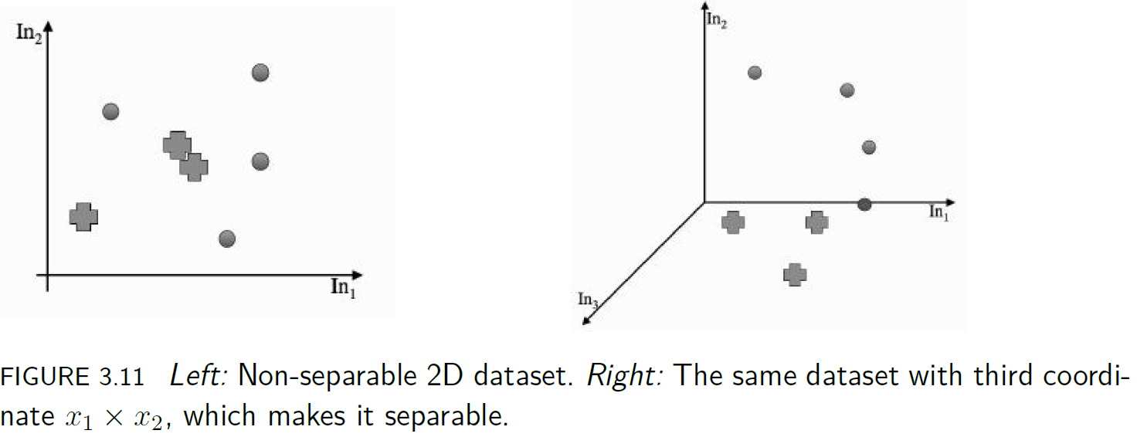
if you want to make your linear Perceptron do non-linear things, then there is nothing to stop you making non-linear variables.

Slide 50
3.4.4 Another Example: The Pima Indian Dataset
The UCI Machine Learning Repository (http://archive.ics.uci.edu/ml/) holds lots of datasets that are used to demonstrate and test machine learning algorithms.

Slide 51
3.4.5 Preprocessing: Data Preparation
Machine learning algorithms tend to learn much more effectively if the inputs and targets are prepared for analysis before the network is trained.
it is normal to scale the targets to lie between 0 and 1
no matter what kind of activation function is used for the output layer neurons.
to scaling the input data is to
treat each data dimension independently,
and then to either make each dimension have zero mean and unit variance in each dimension,
or simply to scale them so that maximum value is 1 and the minimum -1.
the first scaling is a little bit better as it does not allow outliers to dominate as much.

Slide 52
These scalings are commonly referred to as data normalisation, or sometimes standardisation.
In NumPy it is very easy to perform the normalisation by using the built-in np.mean() and np.var() functions;
the only place where care is needed is along which axis the mean and variance are computed:
axis=0 sums down the columns
and axis=1 sums across the rows.

Slide 53
data = (data - data.mean(axis=0))/data.var(axis=0)
targets = (targets - targets.mean(axis=0))/targets.var(axis=0)
to normalise the dataset before splitting it into training and testing.

Slide 54
The last thing that we can do for now is
to perform a basic form of feature selection
and to try training the classifier with a subset of the inputs by missing out different features one at a time
and seeing if they make the results better.
If missing out one feature does improve the results, then leave it out completely and try missing out others as well.
This is a simplistic way of testing for correlation between the output and each of the features.

Slide 55
methods of dimensionality reduction,
which produce lower dimensionsal representations of the data that still include the relevant information

Slide 56
3.5 LINEAR REGRESSION
For regression we are making a prediction about an unknown value y (such as the indicator variable for classes or a future value of some data)
by computing some function of known values x_{i}.
We are thinking about straight lines, so the output y is going to be a sum of the x_{i} values, each multiplied by a constant parameter:

Slide 57
The question is how we define the line (plane or hyperplane in higher dimensions) that best fits the data.
The most common solution is to try to minimise the distance between each datapoint and the line that we fit, which is known as least-squares optimisation.

Slide 58
This can be written in matrix form as:
where t is a column vector containing the targets and X is the matrix of input values (even including the bias inputs), just as for the Perceptron.

Slide 59
Computing the smallest value of this means
differentiating it with respect to the (column) parameter vector β
and setting the derivative to 0,
which means that X^{T} (t − Xβ) = 0
which has the solution β = (X^{T}X)⁻¹X^{T} t (assuming that the matrix X^{T}X can be inverted).

Slide 60
def linreg(inputs,targets):
inputs = np.concatenate((inputs,-np.ones((np.shape(inputs)[0],1))), axis=1)
beta = np.dot(np.dot(np.linalg.inv(np.dot(np.transpose(inputs), inputs)),np.transpose(inputs)),targets)
outputs = np.dot(inputs,beta)

